Slide 1
Publishers’ Criteria for Common Core State Standards for Mathematics
Notes:
This module was last updated on February 2016.
This Professional Development Module provides a deep look into the Publishers’ Criteria for Common Core State Standards for Mathematics to help us understand the expectations and promises of the Common Core.

Slide 2
Objectives
Develop a deeper understanding of the instructional shifts of focus, coherence, and rigor through a study of the Publishers’ Criteria for Mathematics.
Identify examples and non-examples of each criterion in instructional materials.
Notes:
There are two objectives for this professional development module. They are … {read slide}.

Slide 3
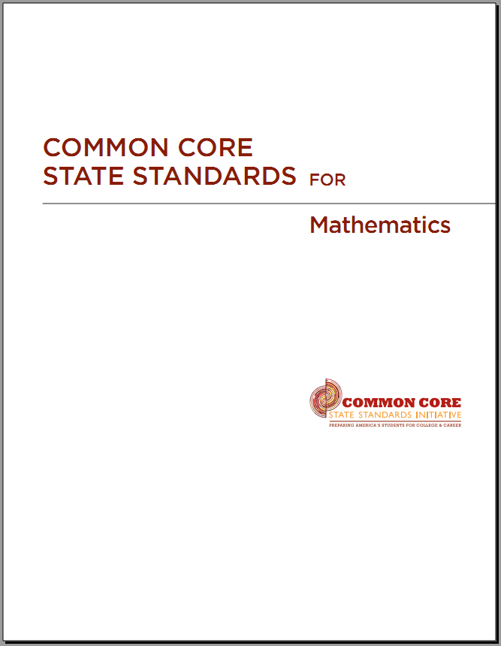
The Three Shifts in Mathematics
Focus strongly where the standards focus
Coherence: Think across grades and link to major topics within grades
Rigor: Require conceptual understanding, fluency, and application
Notes:
There are three Shifts required by the CCSS for mathematics. These Shifts inform us on what is different. The Shifts explain the structure of the Standards and they guide us on what is important.
In all aspects of mathematics education under the Common Core State Standards, whether it is instructional practice, assessment, or aligning materials, each and every decision should be grounded in the shifts that are required by the Standards.
These shifts are focus, coherence, and rigor.
The first shift is to Focus strongly where the standards focus.
The Standards require teachers and curriculum designers to think across grades and link to major topics within grades. This is coherence.
And they require a shift towards an equal intensity in students’ development of conceptual understanding, procedural skill and fluency, and application. This is rigor.
But, as teachers across the country know, the standards themselves being focused, coherent and rigorous is not enough– now it is time for teachers to have in their hands materials that will support them in getting their students to reach these high standards.

Slide 4
“These standards are not intended to be new names for old ways of doing business. They are a call to take the next step.”
−CCSSM, page 5
Notes:
The Common Core State Standards clearly say that “These standards are not intended to be new names for old ways of doing business. They are a call to take the next step.”
This is the message for everyone involved. In the past, state standards might have been revised and it didn’t necessarily have an impact on instruction or for curriculum —what happened in the classroom was business as usual.
That can’t happen here—there are some real changes with these standards. There is no room for old ways of doing business.

Slide 5
Some Old Ways of Doing Business (1 of 2)
A different topic every day
Every topic treated as equally important
Elementary students dipping into advanced topics at the expense of mastering fundamentals
Infinitesimal advance in each grade; endless review
Incoherence and illogic – bizarre associations, or lacking a thread
Notes:
This list represents some of the old ways of doing business in textbooks that are simply not aligned with CCSS.
Some books present a different topic every day and treat every topic as equally important. This goes against the focus and coherence of the Standards. There are cases in which textbooks just use a list of standards as their table of contents – math is not a flat list of topics, this is an old way of doing business.
Some materials had elementary students dipping into advanced work at the expense of mastering fundamentals. This is back to the mentality of students doing a little bit of everything, every year. This leads to infinitesimal advance in each grade with endless review. Have you seen middle school books recently? They don’t list a grade anymore, they are just different colors or animals – red, blue and green for instance. It is almost impossible to know which grade is which in some middle school series even after opening the book, because the topics and level of expectations are minimally varied from each other. Infinitesimal advance in each grade with endless review. There are countless Algebra I books where ½ the year is spent covering middle school material with no indication to the teacher that this material is review.
Books often contain incoherence and illogic. They put topics together that had no right to be together – one chapter of an Algebra book, chapter one, was actually titled “Angles and Order of Operations” This makes no sense. Math should make sense, and all too often the incoherence of textbooks sabotages that.

Slide 6
Some Old Ways of Doing Business (2 of 2)
Lack of rigor
  Reliance on rote learning at expense of concepts
  Aversion to repetitious practice
  Severe restriction to stereotyped problems lending themselves to mnemonics or tricks
  Lack of quality applied problems and real-world contexts
  Lack of variety in what students produce
Notes:
Materials contain a widespread lack of rigor. At one extreme, there is reliance of rote learning at the expense of conceptual understanding – all procedural skill and fluency. At another extreme, there is aversion to repetitious practice – books that dedicate so much time to applications that there is very little opportunity for students to practice the mathematical skills they need to develop. Both exist. Both are old ways of doing business.
Content in a lot of books is severely restricted to stereotyped problems lending themselves to mnemonics or tricks. Assignments contain problems that all looked exactly the same. Who wouldn’t want to use tricks when there is no variety to what is being asked to do? For example, when a student is asked to write “I will not chew gum in class” 100 times, he/she soon realizes that it is easier to write” I” 100 times then “will” 100 times and so on… Students don’t internalize the message “I will not chew gum in class”, they just found a way to do it easier – almost mindless of what they were writing. When students are given math problems that all look the same – the same thing occurs – no internalization – no conceptual understanding – no ability to transfer what they are doing to something just slightly different. They just learn tricks.
There can be a lack of quality applications and real-world contexts, and when they do appear they were often designated into the gutter - into the areas of the text that teachers rarely assigned problems from. There is also a lack of variety in what students are asked to produce. Overwhelmingly students are asked to produce only answers, and very seldom are they asked to produce arguments, diagrams, or models.

Slide 7
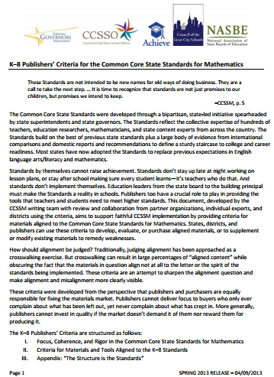
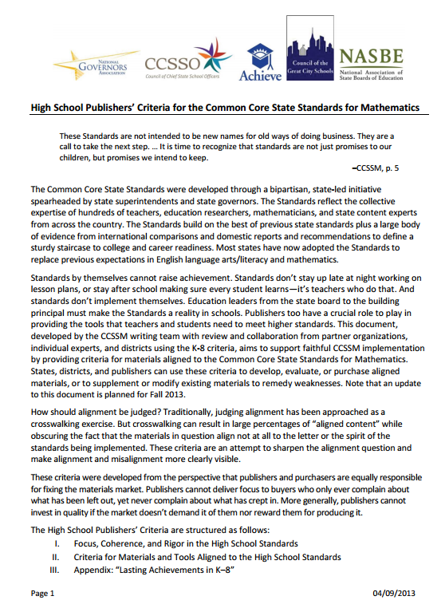
Overview of the K-8 and High School Publishers’ Criteria for Mathematics
Available at:
www.achievethecore.org/publisherscriteria
and
www.corestandards.org/resources
Notes:
The Publishers’ Criteria answers the call to take the next step by giving guidance to how these Shifts apply to instructional materials. The K-8 Publishers’ Criteria for Mathematics, written by the authors of the Standards with support from National Governors Association, CCSSO, Achieve, Council of Great City Schools and NASBE, was released in July 2012. An updated document, as well as the HS Publishers’ Criteria was released in early April, 2013. The Publishers’ Criteria, as I’m sure you’ll agree, makes vivid the Shifts the Standards require and make more concrete some of their implications for instructional materials.
Copies of the Publishers’ Criteria – both K-8 and High School – can be found at the URLs listed above.

Slide 8
Use Cases for the Publishers’ Criteria
Guidance for publishers, district personnel, and educators; both producers and consumers of materials
  Informing purchases and adoptions
  Working with previously purchased materials
  Guiding the development of materials
  As a tool for professional development
Notes:
So, how is this document to be used? As expected, the Criteria was written to guide publishers, inform purchasing, and to support districts when working with previously purchased materials. But, this document can and likely will be used in additional ways.
Reviewing teacher-developed materials and guiding their development
And, as we are doing here today, it can be used as a PD tool. The Publishers’ Criteria is a concise and manageable narrative of the shifts. It allows readers to engage with the Standards through examples, and suggests that readers have a copy of the standards next to them so it also serves as an entry point into that document.
In all these cases, it is recommended that the criteria for focus be attended to first. By attending first to focus, coherence and rigor may realistically develop. Failing to meet any single focus criterion is enough to show that the materials in question are not aligned to the Standards.

Slide 9
Discussing the Criteria
K-8 Publishers’ Criteria
HS Publishers’ Criteria
Includes comprehensive introduction to the Shifts
10 Criteria for K-8 math materials
  Criteria attend to the three Shifts and the incorporation of the Mathematical Practices into curricular materials
Indicators of quality, including comments about lesson structure, kinds of problems, and the visual design of materials
Appendix: The Structure is the Standards
Includes comprehensive introduction to the Shifts
8 Criteria for HS math materials
  Criteria attend to the three Shifts and the incorporation of the Mathematical Practices into curricular materials
Indicators of quality, including comments about lesson structure, kinds of problems, and the visual design of materials
Appendix: Lasting Achievements in K-8
Notes:
In addition to the criteria for math materials, both the K-8 and HS documents contain a comprehensive introduction to the shifts required by the Common Core State Standards. They also contain additional indicators of quality and an essay in the appendix.
The most notable difference between the K-8 document and the HS Publishers’ Criteria is that there are 10 criteria for K-8 and 8 for HS. As you will see on the next slide, there are fewer criteria for HS, simply because there is no supporting work and no need to attend to focus in early grades in high school materials.

Slide 10
Criteria for Focus
High School
Criterion 1: Focus on Widely Applicable Prerequisites: In any single course, students using the materials as designed spend the majority of their time developing knowledge and skills that are widely applicable as prerequisites for postsecondary education.
⁸The materials should devote at least 65% and up to approximately 85% of the class time to the major work of the grade with Grades K–2 nearer the upper end of that range, i.e., 85%.
K-8
Criterion 1. Focus on Major Work: In any single grade, students and teachers using the materials as designed spend the large majority of their time on the major work of each grade.⁸
Criterion 2. Focus in Early Grades: Materials do not assess any of the topics in Table 2 before the grade level indicated.
Criterion 3. Focus and Coherence through Supporting Work: Supporting content enhances focus and coherence simultaneously by engaging students in the major work of the grade.
Notes:
As mentioned before, the most important shift for mathematics, focus, undoubtedly leads to the most important criteria – the criteria of focus.
For K-8 we see there are 3 criteria that specifically address focus. Focus on Major Work, Focus in Early Grades and Focus and Coherence through Supporting Work.
{Read slide.}
It is imperative that materials focus on the Major Work, that they are focused in the early grades and that supporting content – enhances the Major Work of the grade rather than distract from it. Without focusing on the Major Work of the grade, the depth of learning that needs to happen will never be actualized. In K-8, without focus in the early grades (getting away from doing a little bit of everything every year), rigor will be compromised and without supporting work supporting the Major Work, coherence doesn’t exist. Districts know that demanding focused materials is non-negotiable.
Let’s talk a little more about the K-8 criteria for focus.

Slide 11
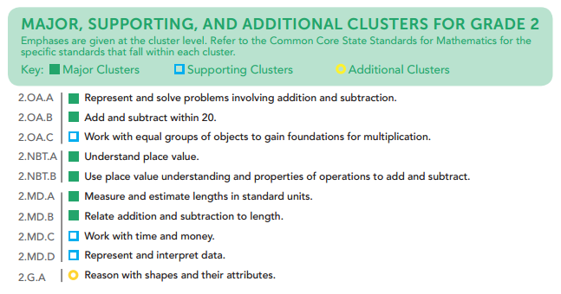
Criterion 1: Focus on Major Work: In any single grade, students and teachers using the materials as designed spend the large majority of their time on the major work of each grade.
Focus by grade level documents available at: www.achievethecore.org/focus
Notes:
For K-8, in any single grade, students using the materials as designed spend the large majority of their time on the Major Work of each grade. This large majority of time ranges from 65-85% with grades K-2 nearer to the upper range of 85%. You can find the Major Work for grades K-8 at achievethecore.org/focus.

Slide 12
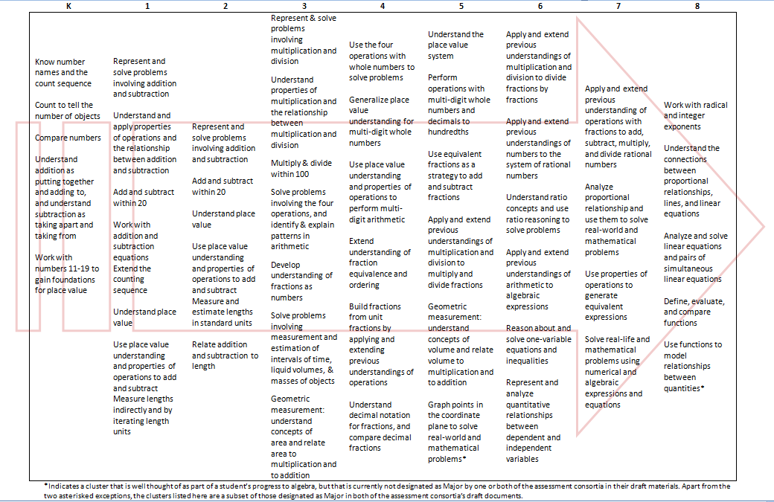
Progress to Algebra in Grades K-8
Notes:
It’s important to know that an important subset of the Major Work of the grade is the progression that leads toward middle-school algebra. Materials should give especially careful treatment to these clusters and their interconnections. This document can be found in the Publishers’ Criteria as well as on the backside of each Focus by Grade Level document (K – 8).

Slide 13
Criterion 2: Focus in Early Grades: Materials do not assess any of the topics in Table 2 before the grade level indicated.
Topic | Grade Introduced
Probability, including chance, likely outcomes, probability models. | 7
Statistical distributions, including center, variation, clumping, outliers, mean, median, mode, range, quartiles, and statistical association or trends, including two-way tables, bivariate measurement data, scatter plots, trend line, line of best fit, correlation. | 6
Similarity, congruence, or geometric transformations. | 8
Symmetry of shapes, including line/reflection symmetry, rotational symmetry. | 4
Notes:
The 2nd criterion for K-8 for focus is Focus in Early Grades. As the table indicates (pg. 10 of the Publishers’ Criteria), the Standards as a whole do include these topics (probability, statistics, similarity, symmetry) —they are not being left out. However, in the coherent progression of the Standards, the first appearance of these topics occurs at later grades in order to establish focus. This table represents a sample of topics that can be obstacles to focus in the early grades. The selection of these topics is because they tend to be indicators that programs are not spending enough time on the Major Work of the grade.
So, in aligned materials there are no chapter tests, unit tests, or other assessment components that make students or teachers responsible for any of these topics before the grade in which they are introduced in the Standards. If teachers are being asked to focus strongly where the standards focus, then we have to pull back where the Standards ask us to. Teachers and students can’t be held responsible for what the Standards don’t require.

Slide 14
Criterion 3: Focus and Coherence through Supporting Work: Supporting content enhances focus and coherence simultaneously by engaging students in the major work of the grade.
Example: Data Representation
Draw a scaled picture graph and a scaled bar graph to represent a data set with several categories. Solve one- and two-step “how many more” and “how many less” problems using information presented in scaled bar graphs. For example, draw a bar graph in which each square in the bar graph might represent 5 pets.
Standard 3.MD.B.3
Notes:
Criterion 3 explains that supporting topics should be treated as such in materials. Connections between supporting work and major work should not be left solely up to the practitioner, but should be made explicit by the materials. Supporting content enhances focus and coherence simultaneously by engaging students in the Major Work of the grade. For example, materials for K–5 generally treat data displays as an occasion for solving grade-level word problems using the four operations, not merely as a discrete topic on its own.

Slide 15
Criteria for Focus
K-8
Criterion 1. Focus on Major Work: In any single grade, students and teachers using the materials as designed spend the large majority of their time on the major work of each grade.⁸
Criterion 2. Focus in Early Grades: Materials do not assess any of the topics in Table 2 before the grade level indicated.
Criterion 3. Focus and Coherence through Supporting Work: Supporting content enhances focus and coherence simultaneously by engaging students in the major work of the grade.
⁸The materials should devote at least 65% and up to approximately 85% of the class time to the major work of the grade with Grades K–2 nearer the upper end of that range, i.e., 85%.
High School
Criterion 1: Focus on Widely Applicable Prerequisites: In any single course, students using the materials as designed spend the majority of their time developing knowledge and skills that are widely applicable as prerequisites for postsecondary education.
Notes:
In HS, there is no need for focus in early grades, nor are there major/additional/supporting designations for the HS Standards, so there is only one criterion for focus. Materials used as designed have students spending the majority of their time devoted to building the particular knowledge and skills that are most applicable and prerequisite to a wide range of college majors and postsecondary programs.

Slide 16
High School Publishers’ Criteria for CCSSM
Criterion 1: Focus on Widely Applicable Prerequisites: In any single course, students using the materials as designed spend the majority of their time developing knowledge and skills that are widely applicable as prerequisites for postsecondary education.
Notes:
In High School, there are not clusters designated as Major Work. So, focus takes on a slightly different approach. In high school courses, key areas of focus are known as Widely Applicable Prerequisites. These are topics that have been identified as being most important for a wide range of college majors and postsecondary programs.

Slide 17
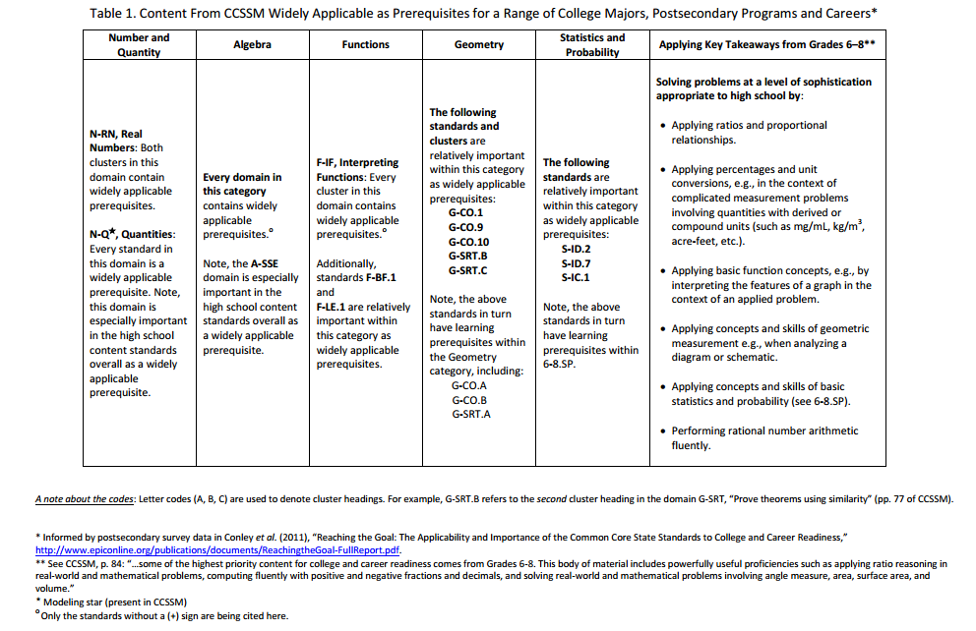
Notes:
This table lists clusters and standards with relatively wide applicability across a range of postsecondary work. It is a subset of the material students must study to be college and career ready. Curricular materials, instruction, and assessment must give especially careful treatment to the domains, clusters, and standards in this table, including their interconnections and their applications—amounting to a majority of students’ time.
This document can be found on page 8 of the High School Publishers’ Criteria.

Slide 18
Engaging with the Criteria
Look at pages 1 – 6 in the Activity Packet
Using what you’ve learned about focus, identify the example that best meets each of the Criteria 1 – 3
Be prepared to share why each example meets or does not meet the given criterion
Notes:
{Explain to participants that there are 10 individual activities, 1 for each criterion. Distribute Activity Packet.}
Now we are going to engage with activities for Criteria 1 – 3 in the packet. Use the following materials:
Criterion 1 – Pacing Guides A & B (Third Grade), Focus by Grade Level– Grade 3
Criterion 2 – Table of Contents C & D (Fifth Grade), Table 2 from Publishers’ Criteria
Criterion 3 – Worksheets E & F (First Grade), Content Standards – Grade 1
Work with a partner or small group, restate in your own words the criterion and what you should be looking for before you get into actually looking at the artifacts. Next, analyze the artifacts for each criterion and decide which example (out of the two possibilities) meets the criterion and which does not. More importantly, discuss WHY the examples do or do not meet the criterion and use evidence in your discussions. Do this for all criteria.
{Pause from presentation to have attendees complete activities for Criteria 1-3, which relate to Focus.}

Slide 19
Publishers’ Criterion 1: Focus on Major Work –
In any single grade, students and teachers using the materials as designed spend the large majority of their time on the major work of the grade.
Pacing Guide A
Pacing Guide B
Wks. | Dom. | Focus Standards
1-2 | NBT | 3.NBT.1; 3.NBT.2
3-4 | MD | 3.MD.3; 3.MD.5a; 3.MD.6
5-7 | OA; MD | 3.OA.1; 3.MD.7; 3.MD.8
8-10 | NBT; OA | 3.NBT.3; 3.OA.5; 3.OA.9
11-13 | OA | 3.OA.2; 3.OA.6
14-16 | OA | 3.OA.3; 3.OA.4
17-20 | OA | 3.OA.7; 3.OA.8
21-23 | MD | 3.MD.1
24-25 | G | 3.G.1; 3.G.2
26-29 | MD; NF | 3.MD.4; 3.NF.1; 3.NF.2
30-33 | NF | 3.NF.3
34-36 | MD | 3.MD.2
Wks. | Dom. | Focus Standards
1-4 | NBT | 3.NBT.1; 3.NBT.2
5-8 | MD | 3.MD.3; 3.MD.4
9-12 | OA; MD | 3.OA.1; 3.MD.7; 3.OA.2; 3.OA.6; 3.OA.5; 3.OA.9
13-15 | NBT | 3.NBT.3
16-19 | OA | 3.OA.3; 3.OA.4; 3.OA.7; 3.OA.8
20-23 | MD | 3.MD.1
24-31 | G; MD | 3.G.1; 3.G.2; 3.MD.8
32-33 | MD; NF | 3.MD.2; 3.NF.1; 3.NF.2; 3.NF.3
34-36 | N&O | MMMR
Notes:
Criterion 1 – Pacing Guides A & B (Third Grade), Focus by Grade Level– Grade 3

Slide 20
Publishers’ Criterion 1: Focus on Major Work –
In any single grade, students and teachers using the materials as designed spend the large majority of their time on the major work of the grade.
Pacing Guide A
Pacing Guide B
Wks. | Dom. | Focus Standards
1-2 | NBT | 3.NBT.1; 3.NBT.2
3-4 | MD | 3.MD.3; 3.MD.5a; 3.MD.6
5-7 | OA; MD | 3.OA.1; 3.MD.7; 3.MD.8
8-10 | NBT; OA | 3.NBT.3; 3.OA.5; 3.OA.9
11-13 | OA | 3.OA.2; 3.OA.6
14-16 | OA | 3.OA.3; 3.OA.4
17-20 | OA | 3.OA.7; 3.OA.8
21-23 | MD | 3.MD.1
24-25 | G | 3.G.1; 3.G.2
26-29 | MD; NF | 3.MD.4; 3.NF.1; 3.NF.2
30-33 | NF | 3.NF.3
34-36 | MD | 3.MD.2
Wks. | Dom. | Focus Standards
1-4 | NBT | 3.NBT.1; 3.NBT.2
5-8 | MD | 3.MD.3; 3.MD.4
9-12 | OA; MD | 3.OA.1; 3.MD.7; 3.OA.2; 3.OA.6; 3.OA.5; 3.OA.9
13-15 | NBT | 3.NBT.3
16-19 | OA | 3.OA.3; 3.OA.4; 3.OA.7; 3.OA.8
20-23 | MD | 3.MD.1
24-31 | G; MD | 3.G.1; 3.G.2; 3.MD.8
32-33 | MD; NF | 3.MD.2; 3.NF.1; 3.NF.2; 3.NF.3
34-36 | N&O | MMMR
Notes:
Let’s debrief and discuss the examples for criteria 1 - 3.
Pacing Guide A meets Criterion 1.
Pacing Guide B does not because it includes more weeks that are not focused on Major Work, including an 8 week-stretch (weeks 24-31, over 20% of the year) focused on additional and supporting work and also includes non grade-level topics.

Slide 21
Publishers’ Criterion 2: Focus in Early Grades –
Materials do not assess any of the topics in Table 2 before the indicated grade.
Book C
Book D
Ch. | Topic
1 | Use Place Value
2 | Add and Sub. Whole #s and Dec.
3 | Multiply Whole Numbers
4 | Divide Whole Numbers
5 | Use Algebraic Expression
6 | Use Equation and Function Tables
7 | Display and Interpret Data
8 | Multiply Fractions
9 | Divide Fractions
10 | Model Add and Subtract Fractions
11 | Use Measures in the Cust. System
12 | Use Measures in the Metric System
13 | Use Probability to Make Predictions
14 | Geometry: Classify; Sim. & Cong.
15 | Finding Mode, Median, and Mean
Ch. | Topic
1 | Understand Place Value
2 | Add and Sub. Whole #s and Dec.
3 | Multiply and Divide Whole Numbers
4 | Multiply and Divide Decimals
5 | Add and Subtract Fractions
6 | Multiply and Divide Fractions
7 | Use Measures in the Customary & Metric System
8 | Geometry: Understand Concepts of Volume
9 | Geometry: Coordinate Plane and Two-Dimensional Shapes
Notes:
Criterion 2 – Table of Contents C & D (Fifth Grade), Table 2 from Publishers’ Criteria

Slide 22
Publishers’ Criterion 2: Focus in Early Grades –
Materials do not assess any of the topics in Table 2 before the indicated grade.
Book C
Book D
Ch. | Topic
1 | Use Place Value
2 | Add and Sub. Whole #s and Dec.
3 | Multiply Whole Numbers
4 | Divide Whole Numbers
5 | Use Algebraic Expression
6 | Use Equation and Function Tables
7 | Display and Interpret Data
8 | Multiply Fractions
9 | Divide Fractions
10 | Model Add and Subtract Fractions
11 | Use Measures in the Cust. System
12 | Use Measures in the Metric System
13 | Use Probability to Make Predictions
14 | Geometry: Classify; Sim. & Cong.
15 | Finding Mode, Median, and Mean
Ch. | Topic
1 | Understand Place Value
2 | Add and Sub. Whole #s and Dec.
3 | Multiply and Divide Whole Numbers
4 | Multiply and Divide Decimals
5 | Add and Subtract Fractions
6 | Multiply and Divide Fractions
7 | Use Measures in the Customary & Metric System
8 | Geometry: Understand Concepts of Volume
9 | Geometry: Coordinate Plane and Two-Dimensional Shapes
Notes:
Book D meets Criterion 2.
Book C does not. Notice that there are topics not part of grade 5 CCSSM present here: Mode, Median, and Mean, probability, similarity & congruence. They’re stuffed in at the end, but they deny focus. Remember: focus compromised is not focus.
Because this indicator is looking for whether topics are assessed, just reviewing the table of contents would not be sufficient to decide if materials are aligned. However, it is very likely that looking at the chapter or unit tests for Chapters 13-15 in Book C would show topics being assessed before they are introduced in the Standards.

Slide 23
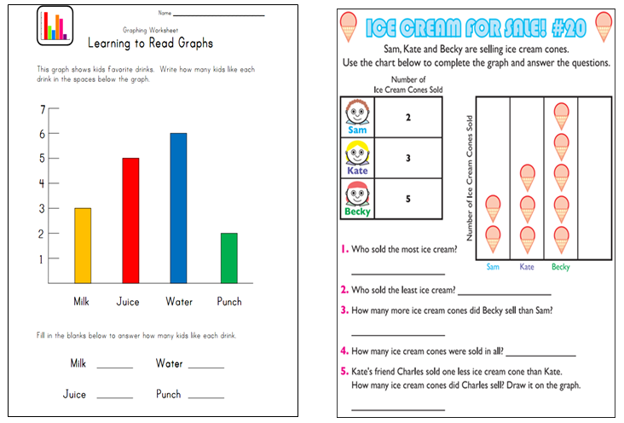
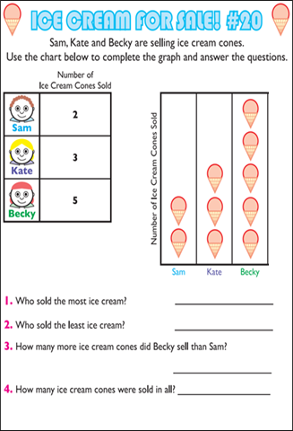
Publishers’ Criterion 3: Focus and Coherence Through Supporting Work – Supporting content enhances focus and coherence simultaneously by engaging students in the major work of the grade.
Worksheet E (1.MD.C.4)
Worksheet F (1.MD.C.4)
Notes:
Criterion 3 – Worksheets E & F (First Grade), Content Standards – Grade 1

Slide 24
Publishers’ Criterion 3: Focus and Coherence Through Supporting Work – Supporting content enhances focus and coherence simultaneously by engaging students in the major work of the grade.
Worksheet E (1.MD.C.4)
Worksheet F (1.MD.C.4)
Notes:
Worksheet F meets Criterion 3.
Worksheet E does not. In grade 1, 1.MD.C.4 is a supporting cluster. That means it should support the Major Work of the grade. In grade 1, focus areas are around addition and subtraction. Worksheet F has students interpret the data given and perform operations on the data (e.g., how many more…, how many… in all), using graphs to support the Major Work of first grade.
{Note: Some participants may note that the 1st grade standard calls for looking at data with three categories and Worksheet E has four. Although there is a small discrepancy between the standards and the specific content of this worksheet, it is not relevant to whether materials align to Criterion 3. }

Slide 25
Rigor and Balance
(Criterion #4 in K-8 and #2 in HS)
Materials and tools reflect the balances in the Standards and help students meet the Standards’ rigorous expectations, by:
Developing students’ conceptual understanding of key mathematical concepts, where called for in specific content standards or cluster headings
Giving attention throughout the year to individual standards that set an expectation of procedural skill and fluency.
Allowing teachers and students using the materials as designed to spend sufficient time working with engaging applications, without losing focus on the major work of each grade.
Notes:
The next criterion addresses rigor and balance. For K-8 this is Criterion 4 and for HS, this is Criterion 2.
After years of the pendulum swinging either fully to procedural skill or fully to conceptual understanding, the CCSS finds the sweet spot by requiring an equal intensity of developing students’ conceptual understanding, giving attention throughout the year to procedural skill and fluency, and allowing sufficient time for students to work with engaging applications that focus on the Major Work of each grade.
Criterion 4 is specifically requiring materials to reflect the balances in the Standards and help students meet the Standards’ rigorous expectations. This demands a balance in developing student’s conceptual understanding of key mathematical concepts, giving attention throughout the year to individual standards that set an expectation of fluency, and allowing teachers and students using the materials as designed to spend sufficient time working with engaging applications without losing focus on the Major Work of each grade.

Slide 26
Which aspect of rigor is expected when?
1. 5.NBT.B.5 Fluently multiply multi-digit whole numbers using the standard algorithm.
2. A-REI.D.10 Understand that the graph of an equation in two variables is the set of all its solutions plotted in the coordinate plane, often forming a curve (which could be a line.)
3. 2.NBT.B.9 Explain why addition and subtraction strategies work, using place value and the properties of operations.
4. 8.EE.C.8c Solve real-world and mathematical problems leading to two linear equations in two variables. For example, given coordinates for two pairs of points, determine whether the line through the first pair of points intersects the line through the second pair.
Notes:
Which aspect of rigor is expected when? This is a big question. Does every lesson need to address all three aspects of rigor? Does every standard require all three aspects of rigor? The answer is no. The Standards themselves are balanced and the Standards themselves will tell you which aspect rigor is expected for that content. Read the standard given and determine, if addressing that standard in isolation, what aspect of rigor should the problems and exercises for that standard represent.
1. 5.NBT.B.5 Fluently multiply multi-digit whole numbers using the standard algorithm. (procedural skill and fluency)
2. A-REI.D.10 Understand that the graph of an equation in two variables is the set of all its solutions plotted in the coordinate plane, often forming a curve (which could be a line.) (conceptual understanding)
When looking through the HS standards it is clear that a big shift is toward conceptual understanding of HS mathematics.
3. 2.NBT.B.9 Explain why addition and subtraction strategies work, using place value and the properties of operations. (conceptual understanding)
What are some other words that would highlight a “conceptual understanding” standard? (Interpret, recognize, describe, explain, distinguish, identify…)
4. 8.EE.C.8c Solve real-world and mathematical problems leading to two linear equations in two variables. For example, given coordinates for two pairs of points, determine whether the line through the first pair of points intersects the line through the second pair. (application)

Slide 27
Additional Aspects of the Rigor and Balance Criterion
The three aspects of rigor are not always separate in materials.
Nor are the three aspects of rigor always together in materials.
Notes:
The three aspects of rigor will not always be addressed together and the three aspects of rigor will not always be addressed separately. So for example, sometimes fluency is just fluency and fact-practice or conceptual understanding is addressed separately because the content calls for it. Other times the aspects of rigor can be combined; an application problem may require students to provide evidence of their conceptual understanding in order to solve the problem.
However, each lesson does not need to contain a balance of these three. The standards themselves will indicate what aspect of rigor needs to be addressed, but it is reasonable that most units or chapters or assessments should aim for a balance of all three over the course of the unit.

Slide 28
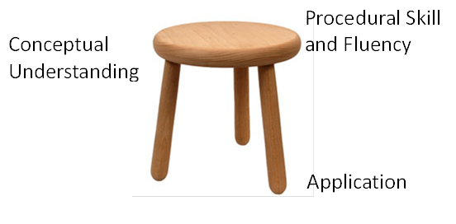
The three legged stool
Notes:
Many people have appreciated the visual of the three legged stool. All three aspects of rigor (conceptual understanding, procedural skill and fluency and application) need to be addressed for students to be able to reach the depth of learning that is expected by the CCSS.

Slide 29
Frequently Asked Questions
How can we assess fluency other than giving a timed test?
What does conceptual understanding look like? How can we assess it?
Aren’t the Common Core State Standards for Math all about application and meaningful tasks?
Notes:
Here are a few other frequently asked questions about the idea of rigor and balance.
How can we assess fluency other than giving a timed test?
The word fluently as used in the standards does refer to time. It means accurate and reasonably fast. The Standards are explicit where fluency is expected. Materials in grades K–6 help students make steady progress throughout the year toward fluent (accurate and reasonably fast) computation, including knowing single-digit products and sums from memory (see, e.g., 2.OA.2 and 3.OA.7). Progress toward these goals is interwoven with students’ developing conceptual understanding of the operations in question.
What does conceptual understanding look like and how can we assess it?
Conceptual understanding is knowing the meaning behind the math. It is knowing the mathematics without tricks and mnemonics and understanding the content thoroughly enough to see connections within the subject. ‘How’ and ‘why’ questions can assess whether a student understands the content. Asking students to show work and explain can be informative, but be careful - it isn’t the only way to assess conceptual understanding and can become tiring for students if used too often. Materials aligned to CCSS will also need to contain problems devised that would be difficult for students to solve without conceptual understanding.
Lastly, are the Common Core Standards in Math all about application and meaningful tasks?
It is a common misconception that CCSSM is only about rich application tasks. As we’ve discussed, ‘application’ is only one of the three aspects of rigor. Students will not master the fluency/procedural skills standards or have a deep conceptual understanding simply by solving performance tasks. Students should be given real world problems and tasks periodically in order to apply their knowledge of the content.

Slide 30
Engaging with the Criteria
Look at pages 7 – 9 in the Activity Packet
Using what you’ve learned about rigor and balance, identify the example that best meets Criterion 4
Be prepared to share why each example meets or does not meet the given criterion
Notes:
{Pause from presentation to have attendees complete activity for Criterion 4, which relates to Rigor and Balance.}
Use these materials for Criteria 4:
Chapter Tests G and H (8th/9th Grade)
Work with a partner or small group to first, restate in your own words what the criterion is asking for and what you should be looking for—before you get into actually looking at the artifacts. Then, analyze the artifacts for Criterion 4 and decide which example meets the criterion and which does not. More importantly, discuss WHY the example meets or does not meet the criterion.

Slide 31
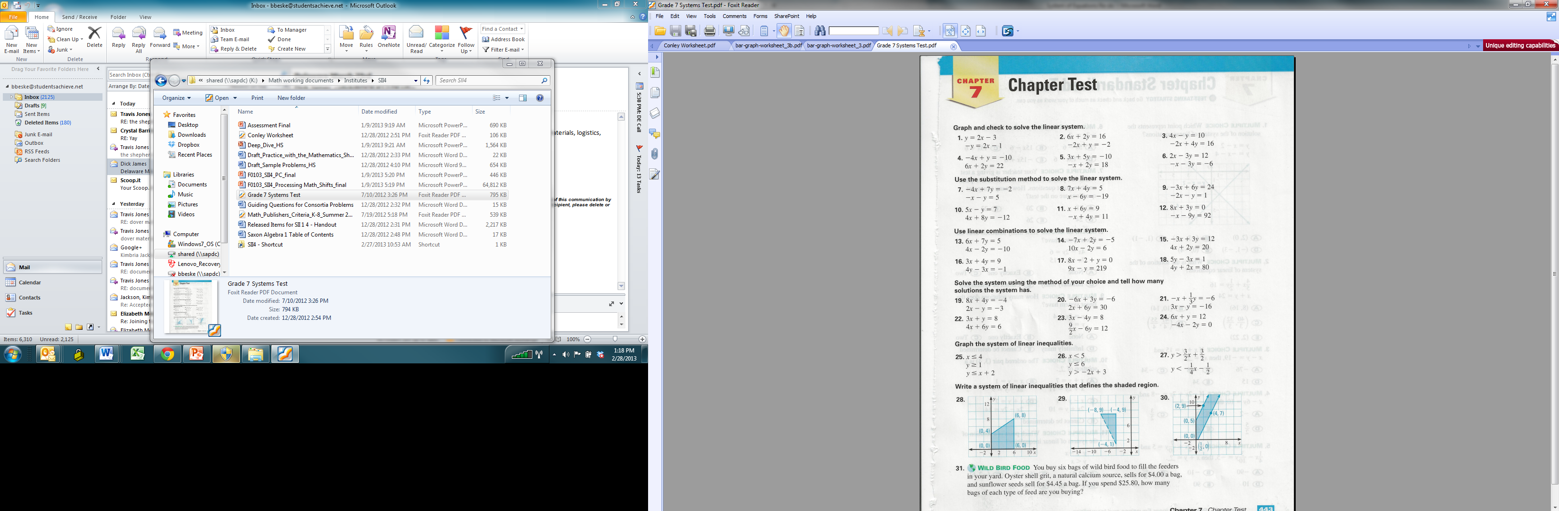
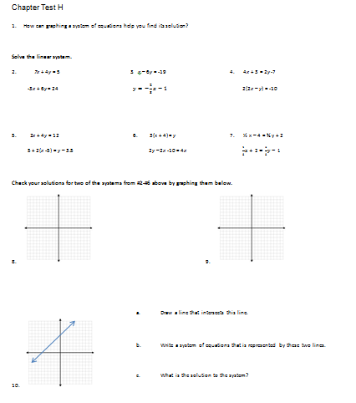
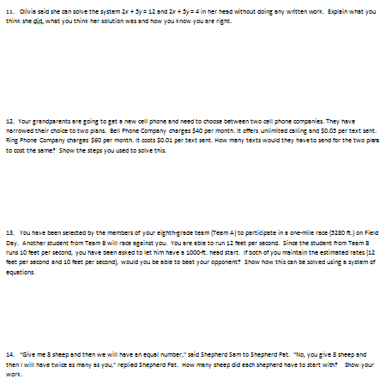
Publishers’ Criterion 4: Rigor and Balance – Materials and tools reflect the balances in the Standards and help students meet the Standards’ rigorous expectations (conceptual understanding, procedural skill and fluency, and application).
Test G (8th/9th Systems)
Test H (8th/9th Systems)
Notes:
Chapter Tests G and H (8th/9th Grade)

Slide 32
Publishers’ Criterion 4: Rigor and Balance – Materials and tools reflect the balances in the Standards and help students meet the Standards’ rigorous expectations (conceptual understanding, procedural skill and fluency, and application).
Test G (8th/9th Systems)
Test H (8th/9th Systems)
Notes:
Test G is typical of a traditional assessment. It does not meet the criterion. All the equations are given in the same format. The directions tell you which method to use. It is very heavy in procedural skill, with one lonely word problem in the gutter.
Test H meets the criterion. It asks conceptual questions, does not tell the student which method to use (it is up to the student to decide the best method given the structure and content in the equations), assesses fluency in skills like graphing equations, and offers real-world application problems to solve.

Slide 33
Criterion 5: Consistent Progressions
Materials are consistent with the progressions in the Standards, by (all of the following):
Basing content progressions on the grade-by-grade progressions in the Standards.
Giving all students extensive work with grade-level problems.
Relating grade-level concepts explicitly to prior knowledge from earlier grades.
Notes:
The next two criteria are about two types of coherence: coherence across grades and courses and coherence within a grade or course. Coherence is an important design element of the standards. The standards are not so much built from topics as they are woven out of progressions.
The criterion for coherence across grades asks for materials to be consistent with the progressions in the Standards. Materials need to pay careful attention to how the mathematical progressions develop over time in the Standards and what is expected at each grade level.
Students need extensive time to work with grade-level problems, not problems from previous grades but grade-level problems. The Standards say on page 4, that “all students must have the opportunity to learn and meet the same high standards if they are to access the knowledge and skills necessary in their post-school lives”. All students deserve exposure to grade-level problems. This also begins to get at the issue of endless review. At some point we need students to have access to grade-level content.
Of course math topics are not discrete items, however. These standards are built from mathematical progressions. Materials should also explicitly relate prior knowledge from earlier grades to current grade-level concepts where applicable.

Slide 34
Criterion 6: Coherent Connections
Materials foster coherence through connections at a single grade, where appropriate and where required by the Standards, by (all of the following):
Including learning objectives that are visibly shaped by CCSSM cluster headings.
Including problems and activities that serve to connect two or more clusters in a domain, or two or more domains in a grade, in cases where these connections are natural and important.
Preserving the focus, coherence, and rigor of the Standards even when targeting specific objectives.
Notes:
Criterion 6 looks for materials to foster coherence within a grade. This criterion asks that learning objectives, where appropriate, be shaped by CCSS cluster headings and that materials contain problems and activities that serve to connect two or more clusters in a domain or two or more domains in a grade in cases where these connections are natural and important. Not all learning objectives, problems, or activities should be coded to one particular standard. The table of contents shouldn’t necessarily look like a list of standards. As consumers, we must know the progressions. We must know what is expected at each grade level so we can demand these things of our materials.
Not every learning objective must be directly and uniquely linked to one and only one standard. Some should be informed by cluster headings (e.g. build upon previous understandings of multiplication and division…) and some should connect standards in the ways listed in part B.

Slide 35
Engaging with the Criteria
Look at pages 10 – 11 in the Activity Packet
Using what you’ve learned about coherence, identify the example that best meets each of the Criteria 5 – 6
Be prepared to share why each example meets or does not meet the given criterion
Notes:
{Pause from presentation to have attendees complete activity for Criteria 5 and 6, which relate to Coherence.}
Use the following materials for Criteria 5 and 6:
Middle School Scope and Sequence I and J
Learning Objectives K and L (Algebra 1)
Working with a partner or small group, first restate in your own words what the criterion is asking for and what you should be looking for—before you get into actually looking at the artifacts. Then, analyze the artifacts for Criteria 5 and 6 and decide which example meets the criterion and which does not. More importantly, discuss WHY the example meets or does not meet the criterion.

Slide 36
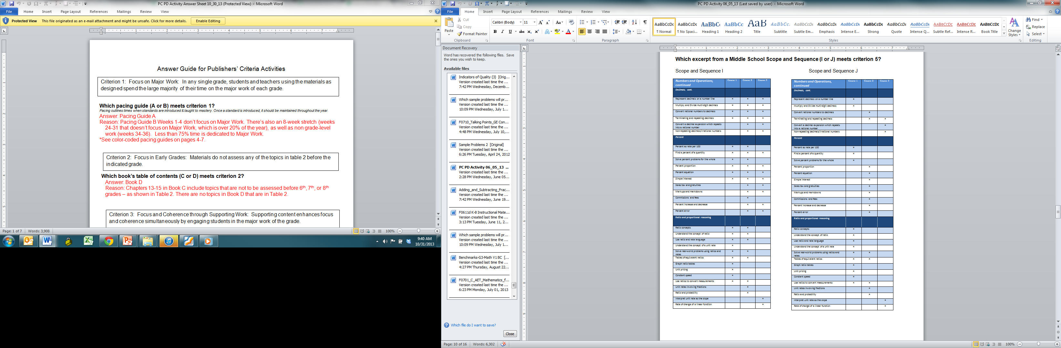
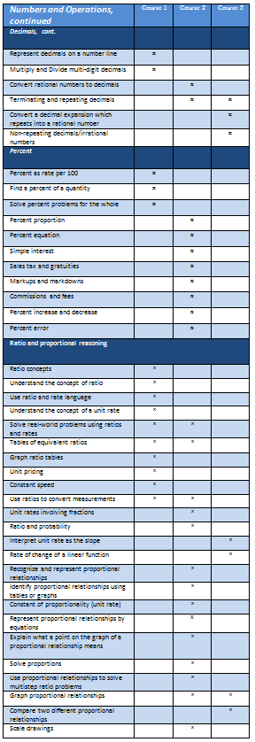
Publishers’ Criterion 5: Consistent Progressions – Materials are consistent with the progressions in the Standards.
Middle School Scope & Sequence I
Middle School Scope & Sequence J
Notes:
Middle School Scope and Sequence I and J

Slide 37
Publishers’ Criterion 5: Consistent Progressions – Materials are consistent with the progressions in the Standards.
Middle School Scope & Sequence I
Middle School Scope & Sequence J
Notes:
Scope & Sequence I does not meet the criteria. It contains everything. Every year. 13 topics show up in all three courses!
Scope & Sequence J meets the criterion. You can see the progression through the courses and structure in content.

Slide 38
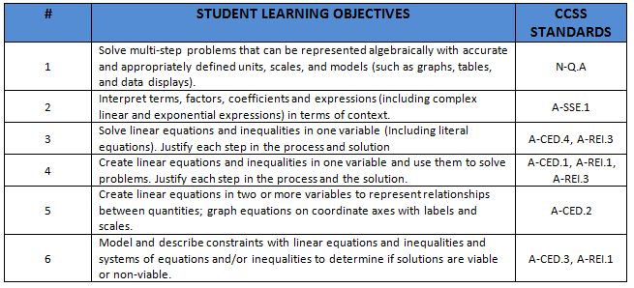
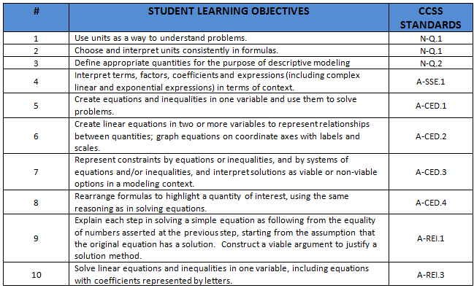
Publishers’ Criterion 6: Coherent Connections –
Materials foster coherence through connections at a single grade, where appropriate and where required by the Standards.
Learning Objectives K
(Alg. 1 Unit 1)
Learning Objectives L (Alg. 1 Unit 1)
Notes:
Learning Objectives K and L (Algebra 1)

Slide 39
Publishers’ Criterion 6: Coherent Connections –
Materials foster coherence through connections at a single grade, where appropriate and where required by the Standards.
Learning Objectives K
(Alg. 1 Unit 1)
Learning Objectives L (Alg. 1 Unit 1)
Notes:
Learning Objectives K meets the criterion. There are great connections between important HS work in Algebra. Lesson #4, for example has students creating and solving equations, as well as explaining the steps needed to do so rather than taking on each of those 3 standards (A-CED.1, A-REI.1, and A-REI.3) as separate discrete topics.
Learning Objectives L does not meet the criterion. Each lesson is aligned to one and only one standard, looking much more like a list of the standards (in order!) than a coherent flow of topics and ideas.

Slide 40
Criterion 7: Practice-Content Connections
Materials meaningfully connect content standards and practice standards.
  “Designers of curricula, assessments, and professional development should all attend to the need to connect the mathematical practices to mathematical content in mathematics instruction.” (CCSSM, p. 8.)
Notes:
{Note: this criterion spans three slides}
Criteria 7 through 10 address the importance of the connection between the Standards for Mathematical Content and the Standards for Mathematical Practice. Practices cannot be done to students, materials need to support teachers in eliciting the practices from students.
In math we have two distinct lists of standards: Standards for Mathematical Content and Standards for Mathematical Practice, and they can’t be addressed separately. The Standards issue a call to connect these two lists on page 8.
A good example of this is mathematical Practice Standard 3: Construct viable arguments and critique the reasoning of others. Generally we are talking about mathematical reasoning. But we can’t just reason, we have to reason about something. And that content has to come from the context of the grade level standards.
There shouldn’t be lessons on “reasoning” or “modeling” that are not connected to the content standards for that grade. There shouldn’t be lessons on “how to persevere” or “how to look for and make use of structure” that aren’t connected to the content standards for that grade.

Slide 41
Criterion 7: Practice-Content Connections
What does it look like for materials to meaningfully connect content standards and practice standards? (1 of 2)
Over the course of any given year of instruction, each mathematical practice standard is meaningfully present and well-grounded in the content standards.
Materials are accompanied by an analysis, aimed at evaluators, of how the authors have approached each practice standard in relation to content within each applicable grade or grade band.
Notes:
Educators sometimes wonder, what does it look like for materials to meaningfully connect content and practice standards?
{Read bullet points on this slide and the next one.}

Slide 42
Criterion 7: Practice-Content Connections
What does it look like for materials to meaningfully connect content standards and practice standards? (2 of 2)
Materials do not treat the practice standards as static across grades or grade bands, but instead tailor the connections to the content of the grade and to grade-level-appropriate student thinking.
Materials also include teacher-directed materials that explain the role of the practice standards in the classroom and in students’ mathematical development.
Notes:
{Read bullet points.}

Slide 43
Criterion 8: Focus and Coherence via Practice Standards
Materials promote focus and coherence by connecting practice standards with content that is emphasized in the Standards.
Content and practice standards are not connected mechanistically or randomly, but instead support focus and coherence.
Materials connect looking for and making use of structure (MP.7) with structural themes emphasized in the standards such as properties of operations, place value decompositions of numbers, numerators and denominators of fractions, numerical and algebraic expressions, etc.
Notes:
Materials also need to promote focus and coherence by particularly connecting practice standards with content that is the Major Work of the grade. A good use of constructing arguments and critiquing the reasoning of others (MP.3) would be in the areas of mathematics that are most important for students to develop deep conceptual understanding in and that lie on the progression towards Algebra.

Slide 44
Criterion 8: Focus and Coherence via Practice Standards
Materials connect looking for and expressing regularity in repeated reasoning (MP.8) with major topics by using regularity in repetitive reasoning as a tool with which to explore major topics.
  In K-5, materials shed light on, e.g., the 10 x 10 addition table, the 10 x 10 multiplication table, the properties of operations, the relationship between addition and subtraction or multiplication and division, and the place value system;
  In 6-8, materials shed light on proportional relationships and linear functions;
  In high school, materials shed light on formal algebra as well as functions, particularly recursive definitions of functions.
Notes:
Another example of how this Criterion applies to math materials is looking at how those materials treat MP.8. {Read K-5, 6-8, & HS bullets.}

Slide 45
Criterion 9: Careful attention to Each Practice Standard
Materials attend to the full meaning of each practice standard. A few examples (1 of 3)
MP.1 does not say, “Solve problems.” Or “Make sense of problems.” Or “Make sense of problems and solve them.” It says “Make sense of problems and persevere in solving them.”
Thus, students using the materials as designed build their perseverance in grade-level-appropriate ways by occasionally solving problems that require them to persevere to a solution beyond the point when they would like to give up.
Notes:
It is also important for the attention to be made for the full meaning of each practice standard, not just superficial coverage. MP.1 – Make sense of problems and persevere in solving them doesn’t mean do problems or just solve problems, but for students to have opportunities to solve grade-level appropriate problems that they need to make sense of and that requires them to persevere to a solution beyond the point when they would like to give up. Materials need to give students opportunities to engage in the full meaning of the practice standards.

Slide 46
Criterion 9: Careful attention to Each Practice Standard
Materials attend to the full meaning of each practice standard. A few examples (2 of 3)
MP.5 does not say, “Use tools.” Or “Use appropriate tools.” It says “Use appropriate tools strategically.”
Thus, materials include problems that reward students’ strategic decisions about how to use tools, or about whether to use them at all.
Notes:
Use appropriate tools strategically MP.5 doesn’t mean simply “use a calculator.” Telling students to use a calculator doesn’t fulfill this criteria. Note that this also isn’t limited to technological tools. Other things are tools too: number lines, visual models, a coordinate grid.

Slide 47
Criterion 9: Careful attention to Each Practice Standard
Materials attend to the full meaning of each practice standard. A few examples (3 of 3)
MP.8 does not say, “Extend patterns.” Or “Engage in repetitive reasoning.” It says “Look for and express regularity in repeated reasoning.”
Thus, it is not enough for students to extend patterns or perform repeated calculations. Those repeated calculations must lead to an insight (e.g., “When I add a multiple of 3 to another multiple of 3, then I get a multiple of 3.”).
Notes:
Another example you might consider is how materials address MP.8. Asking students to extend patterns or reason repetitively are not accurately addressing MP.8. Students should be drawing conclusions on their own based on the work they engaged with, to get at the full intent of MP.8.

Slide 48
Criterion 10: Emphasis on Mathematical Reasoning
Materials support the Standards’ emphasis on mathematical reasoning, by (all of the following):
Prompting students to construct viable arguments and critique the arguments of others concerning key grade-level mathematics that is detailed in the content standards (cf. MP.3).
Engaging students in problem solving as a form of argument.
Explicitly attending to the specialized language of mathematics.
Notes:
Finally, Criterion 10 demands for materials to support the emphasis the Standards have on mathematical reasoning.
{Read slide.}
It’s important to note for part b: we’re not always talking about a verbal explanation. Problem solving can be a form of argument as well.

Slide 49
Engaging with the Criteria
Look at pages 12 – 16 in the Activity Packet
Using what you’ve learned about the importance of connecting content standards and practice standards, identify the example that best meets each of the Criteria 7 – 10
Be prepared to share why each example meets or does not meet the given criterion
Notes:
{Pause from presentation to have attendees complete activity for Criteria 7-10, which address the importance of the connection between the Standards for Mathematical Content and the Standards for Mathematical Practice.}
Use following materials for Criteria 7-10:
Criterion 7: Tasks M and N (Fifth Grade)
Criterion 8: Projects O and P (Fourth Grade)
Criterion 9: Table with Math Practices and Problems
Criterion 10: Table with problems
Working with a partner or small group, first restate in your own words what each criterion is asking for and what you should be looking for—before you get into actually looking at the artifacts. Then, analyze the artifacts for Criteria 7 - 10 and decide which example meets the criterion and which does not. More importantly, discuss WHY the example meets or does not meet the criterion.

Slide 50
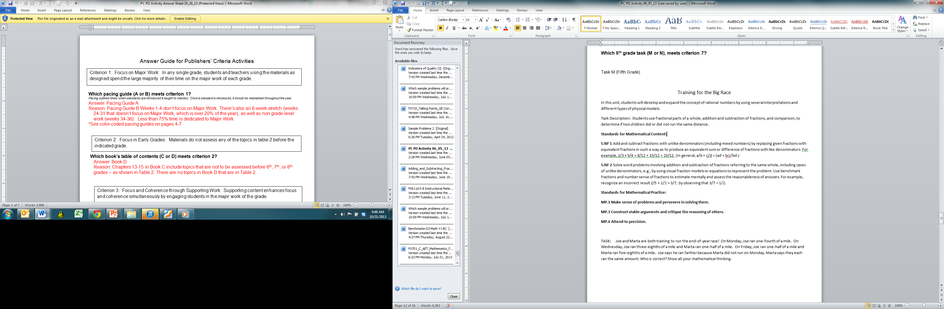
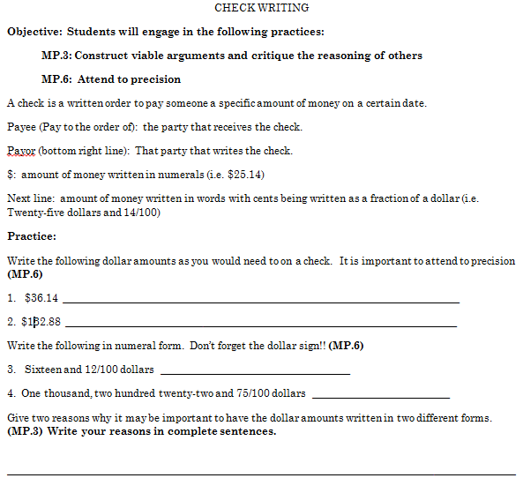
Publishers’ Criterion 7: Practice-Content Connections – Materials meaningfully connect content standards and practice standards.
Task M (5th Grade)
Task N (5th Grade)
Notes:
Criterion 7: Tasks M and N (Fifth Grade)

Slide 51
Publishers’ Criterion 7: Practice-Content Connections – Materials meaningfully connect content standards and practice standards.
Task M (5th Grade)
Task N (5th Grade)
Notes:
Task M meets Criterion 7. It requires students to engage with the mathematical practices and content that focuses on the Major Work in 5th grade. Students need to use the practices as well as their understanding of adding and subtracting fractions with unlike denominators in order to form an answer/argument for this problem.
Task N requires that students focus on practicing the practices listed – not in a meaningful way. It does not meet Criterion 7.

Slide 52
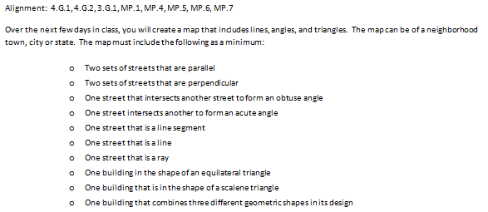
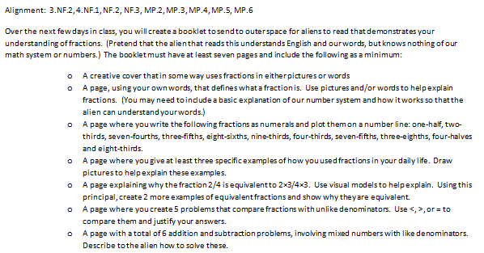
Publishers’ Criterion 8: Focus and Coherence via Practice Standards – Materials promote focus and coherence by connecting practice standards with content that is emphasized in the Standards.
Project O (Geometry Map, 4th Grade)
Project P
(Freaky Fractions Portfolio,
4th Grade)
Notes:
Criterion 8: Projects O and P (Fourth Grade)

Slide 53
Publishers’ Criterion 8: Focus and Coherence via Practice Standards – Materials promote focus and coherence by connecting practice standards with content that is emphasized in the Standards.
Project O (Geometry Map, 4th Grade)
Project P
(Freaky Fractions Portfolio,
4th Grade)
Notes:
Firstly, the practice standards should connect to content that is emphasized in the Standards. While Project O is grade level work, it is not Major Work of the grade. MP.1 is named, but is it really present? Project O does not meet Criterion 8.
For Project P, you can see the vertical coherence of the standards as the project entails related skills from standards from an earlier grade. The project is centered on Major Work of the grade. Project P meets Criterion 8.

Slide 54
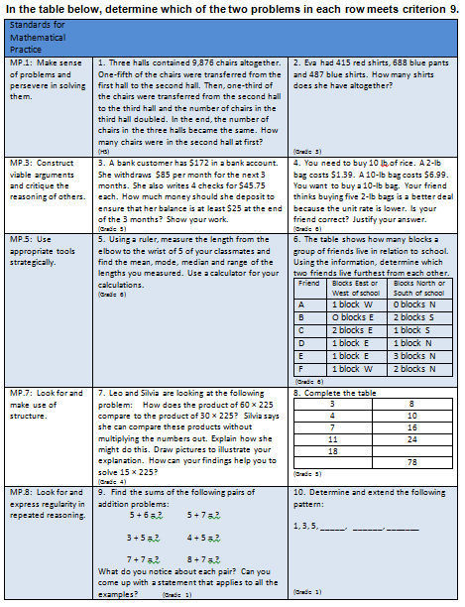
Publishers’ Criterion 9: Careful attention to each practice standard – Materials attend to the full meaning of each practice standard.
Notes:
Criterion 9: Table with Math Practices and Problems

Slide 55
Publishers’ Criterion 9: Careful attention to each practice standard – Materials attend to the full meaning of each practice standard.
Notes:
MP.1 – Problem 1 meets Criterion 9. High School students must make sense of the problem given, working with fractional parts of whole numbers, to determine how many chairs were in the second hall at first. This is a multi-step problem in which each step is important to arriving at the correct answer. Students may demonstrate productive struggle as they make sense of what the problem is asking.
Problem 2 does not meet Criterion 9.
MP.3 – Problem 4 meets Criterion 9. Students must first perform the operations needed to determine how much five 2 lb. bags of rice will cost. Once they’ve figured out which price is lower they must decide if the friend was correct and justify why they think that. This problem asks students to support their reasoning with evidence.
Problem 3 does not meet Criterion 9.
MP.5 – Problem 6 meets Criterion 9. Students are given a problem to solve absent any instruction or guidance as to what tool(s) might be most helpful to solve that problem. The absence of teacher direction allows students to determine what tool(s) are appropriate for solving that type of problem.
Problem 5 does not meet Criterion 9. It begins by telling students to use a ruler to measure and ends with telling students to use a calculator to find the mean, mode, and median. If students are being told what tools to use, the materials are not attending the full meaning of MP.5.
MP.7 – Problem 7 meets Criterion 9. The numbers in problem 7 have been carefully chosen to guide students to use the structure of the numbers to solve the problem. It relates 60 to 30 to 15 – dividing each number by 2 or cutting it in half once and in half again. Students are able to use what they know about numbers to see that relationship and use that structure to find an answer.
Problem 8 does not meet Criterion 9. Completing a table is not making use of structure.
MP.8 – Problem 9 meets Criterion 9. Students in first grade can see that in each set of problems one addend stays the same and the other is increased by one. Students notice that calculations are repeated and are drawn to look for a shortcut or use an opportunistic strategy to solve.
Problem 10 does not meet Criterion 9.

Slide 56
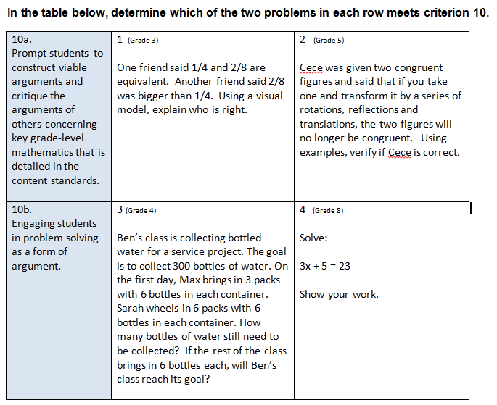
Publishers’ Criterion 10: Emphasis on Mathematical Reasoning – Materials support the Standards’ emphasis on mathematical reasoning.
How do you know?
Notes:
Criterion 10: Table with problems

Slide 57
Publishers’ Criterion 10: Emphasis on Mathematical Reasoning – Materials support the Standards’ emphasis on mathematical reasoning.
How do you know?
Notes:
10a. Though both questions prompt students to construct viable arguments, because transformations are not part of grade 5 in the CCSSM, problem 2 does not meet Criterion 10, since 10a asks for it to happen concerning key grade-level mathematics.
10b. Problem 3 meets Criterion 10 because students have to solve the problem mathematically, answer the two questions (How many bottles are still needed?, Will Ben’s class reach its goal?) and then explain how they know. While problem 4 asks students to show their work, the problem does not support the Standards’ emphasis on mathematical reasoning.

Slide 58
Indicators of Quality (1 of 2)
Problems are worth doing
Variety in the pacing and grain size of content coverage
Variety in what students produce
Lessons are thoughtfully structured ad support the teacher
Separate teacher materials that support and reward teacher study
Use of manipulatives follows best practices
Materials are carefully reviewed (freedom from mathematical errors, grade-level appropriateness, freedom from bias, freedom from construct-irrelevant language complexity)
Notes:
The Indicators of Quality are additional considerations when reviewing materials. Some that stand out are:
Problems are worth doing – this is similar to the Literacy concept of texts worth reading. Let’s not give students exercises without purpose but problems worth doing, problems with a purpose.
There need to be separate teacher materials that support and reward teacher study including discussion on anticipating a variety of students responses, guidance on lesson flow, guidance on questions that best prompt students thinking and discussion of desired mathematical behaviors being elicited among students.
The use of manipulatives follow best practices: manipulatives are a tool to understand math – not the math themselves. Materials shouldn’t assess whether students understand how to use manipulatives, there should be a plan for manipulatives to be weaned from and manipulatives should represent the mathematics faithfully, not be a burden to have to unlearn.

Slide 59
Indicators of Quality (2 of 2)
Visual design isn’t distracting, chaotic, aimed at adult purchasers – serves only to support young students in engaging thoughtfully with the subject
Support for English language learners is thoughtful and helps those learners to meet the same standards as all other students
(For paper-based materials.) A textbook that is focused is short. For example, by design Japanese textbooks have less than one page per lesson. Elementary textbooks should be less than 200 pages, middle and secondary less than 500 pages
Notes:
Visual design should not be distracting and chaotic. Many books contain endless photos of people hanging gliding and high diving, side bars and wild fonts or colors. All of this can make it difficult to find the math within the book. We must demand from books a visual design that supports students engaging with math, not chaos that is designed to “look interesting” to adult purchasers.
And very importantly - support for English language learners needs to be thoughtful and helpful so that all students can meet the same standards.
When reading the Publishers’ Criteria, you will get a better sense of each of these. As the Criteria are not a substitution for Standards, this presentation is by no means a substitution for the Publishers’ Criteria. Take the time to really read it and digest it to best help you make the important purchasing and adoption decisions ahead of you.

Slide 60
Additional Elements of Publishers’ Criteria
Overarching criteria for supporting special populations
Criteria for science materials
Appendix: The Structure is the Standards
Notes:
There are a few more elements that haven’t been mentioned that are part of the Publishers’ Criteria. Those include:
Overarching criteria for supporting special populations
criteria for science materials
an essay entitled “The Structure is the Standards”
and a sample rubric.
An Instructional Materials Evaluation Tool has been developed beyond what the sample rubric offers.

Slide 61
Instructional Materials Evaluation Tool
Draws directly from the K-8 Publishers’ Criteria and the Common Core State Standards for Mathematics
Designed to help educators determine whether instructional materials are aligned to the Shifts and major features of the CCSS
An evaluation tool that can be used for:
  Purchasing new curricular materials
  Evaluating existing materials
  Developing aligned math curricula
Instructional Materials Evaluation Tool available at achievethecore.org/imet
Notes:
The Instructional Materials Evaluation Tool, or IMET, comes directly from the Publishers’ Criteria and the Common Core State Standards and has been designed to help evaluate materials.
It consists of Non-Negotiable Alignment Criteria, Alignment Criteria, and Additional Indicators of Quality
Just like the Publisher’s Criteria, the IMET should be used for:
Informing decisions about purchasing a comprehensive textbook or textbook series
Evaluating existing materials to identify necessary modifications
Building the capacity of educators to better understand what CCSS-aligned textbooks look like
Informing publishers of the criteria that consumers will use to evaluate textbooks

Slide 62
Publishers’ Criteria for Mathematics:
Next Steps for Educators/Policy-makers
Use Cases
What States, Districts and Teachers Can Do
Informing purchases and adoptions
Ensure that instructional resource purchasing criteria and decisions are aligned to the Publishers’ Criteria.
Working with previously purchased materials
Use the Publishers’ Criteria to review existing materials and adjust to improve alignment (remove or supplement).
Reviewing teacher-developed materials and guiding their development
Use the Publishers’ Criteria to support teachers in developing materials and ensure that teacher-developed resources are aligned.
As a tool for professional development
Share the Publishers’ Criteria with teachers and use it to support teacher understanding of the standards.
For additional resources for educators, go to achievethecore.org.
Notes:
Use cases for the Publishers’ Criteria were mentioned at the beginning of the presentation. Here are now some next steps that you can do.
{Read slide.}

